Slide 1
Social Good at Cloud Scale
Michael Lanzetta
Notes:
I’ll be talking to you about some of the work done by my team, using ML and Deep Learning to dramatic effect on projects for social and animal welfare.

Slide 2

Deep Learning, Broad Impact
Machine Learning and Deep Learning has the chance to be a massive force for good in the world. I’ll discuss four projects we’ve worked on in that area:
Helping aid workers in Libya
Helping quantify the impact of illegal mining in Ghana
Finding disaster victims using facial recognition
Tracking endangered species

Slide 3
Who We Are
MSFT / SMSG / CSE / DWR / MLDS
OMGWTF?!
Working with Partners
Across numerous disciplines
On really hard problems
And sharing the solutions
Notes:
We’re a team within MSFT’, but there are so many acronyms it’s not even worth translating.
It suffices to say we’re a team that works with partners across numerous disciplines (like Blockchain, IoT, Big Data, and ML/DL),
On hard problems for which MSFT doesn’t have an out-of-the-box solution. We then share those solutions (or as much as we can)
Via OSS, code stories, and talks like this one.

Slide 4





Working With Partners
Notes:
We work with dozens of Fortune 500 partners including the ones on this slide, but also many more (and even more household) names which we’re not allowed to mention.

Slide 5




…Not All Fortune 500
Notes:
But we don’t just work with Fortune 500 – we love working with organizations like the UN and the Red Cross,
And even smaller conservation-related groups like Conservation Metrics, or academics.

Slide 6
Sharing The Solutions
Code Stories
https://www.microsoft.com/developerblog/
Open-Source Repos
You’ll see GitHub links throughout the talk
(Almost) All code is MIT Licenced
Talks, like this one
Notes:
Once we hand off our engagement, we’ll share what we can.
Via code stories on our blog
Via open-source repos on GitHub – you’ll see many in this talk, and all of them are MIT licensed (where possible)
And via talks

Slide 7
UN/OCHA
Measuring impact of aid in Libya
How can I measure the impact of aid when …
… I’m not allowed into the country
… I can’t pay people to check – as it would put them in harm’s way
… Newspapers are unreliable narrators
Notes:
The first project I wanted to discuss is our work with the UN’s Office for Coordinating Humanitarian Aid.
We were called in to help with a problem they had:
There were just a few agents monitoring all of the Middle East and Africa, and they needed to determine whether aid efforts were successful in some very dangerous places.
How do you measure the impact of aid in Libya…
… when you can’t go into the country and check – it’s too dangerous
… you can’t pay others to go in for you
… and newspapers may not exist in some areas, or may be unreliable (captured by the local warlord)

Slide 8
Scaling Out
Initial Solution
Ingest from multiple sources (Twitter, public Facebook, RSS feeds)
Process by chunk in PySpark
Tag locations using fuzzy matching
Tag sentiment using custom sentiment model (Arabic + emoji)
Tag keywords using fuzzy matching and entity tagging
PySpark was too slow, NLTK was too heavyweight, Arabic sentiment classifier was too innacurate
The Trump Problem, or #BenghaziGate
Notes:
So initially we built a system that could ingest data from multiple sources (twitter, facebook, RSS)
Process in chunks using PySpark
Tag locations + keywords using fuzzy matching to a fixed list of locations + keywords of interest we were given
Built a custom sentiment model using emoji to help improve an Arabic baseline
We found that this system was too slow primarily due to PySpark (slowed processing), and our use of NLTK (slowed cluster startup).
We also ran into something I like to call the “Trump problem” – our feed was being drowned in tweets about Benghazi.
So we reimplemented…

Slide 9
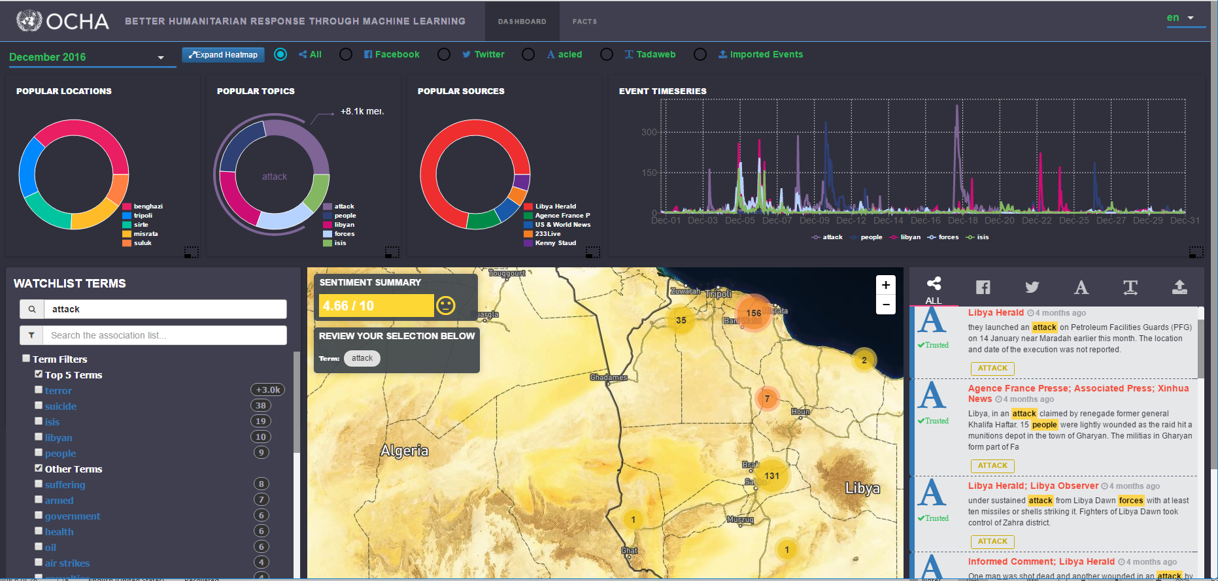
Notes:
This is the dashboard we ended up building, with a list of keywords that drives the rest of the page:
A quick overview of the most popular locations, topics, and sources associated with the term
A timeline showing the frequency of occurrence of the term, so the agent can see if/when it’s spiking
A heatmap allowing them to zoom into areas of interest and check out the sentiment
The actual list of tweets/articles where the term occurs so they can see if we’re hitting another “Benghazi problem”

Slide 10
Evolving The Solution
Define regions of interest
Use Mapbox and PostGres/GIS to determine locales
Use Microsoft Translator for Arabic => English
Process data as it arrives using Azure Functions (~= AWS Lambda)
Use Compromise for light-weight entity tagging
Cook the tagged data in Spark using Scala
PySpark was still too slow when using UDFs (User Defined Functions)
This is changing!
DataBricks on Azure is making Spark easier (better than HDInsight)
Surface the data using GraphQL
Notes:
How did we get there?

Slide 11
Sharing
https://www.microsoft.com/developerblog/2017/06/06/geocoding-social-conversations-nlp-javascript/
https://www.microsoft.com/developerblog/2017/05/10/graphql-providing-context-into-global-crisiss-and-social-public-data-sources/
https://www.microsoft.com/developerblog/2017/11/20/opener-permissively-licensed-named-entity-recognition-on-the-jvm/
https://github.com/CatalystCode/project-fortis

Slide 12
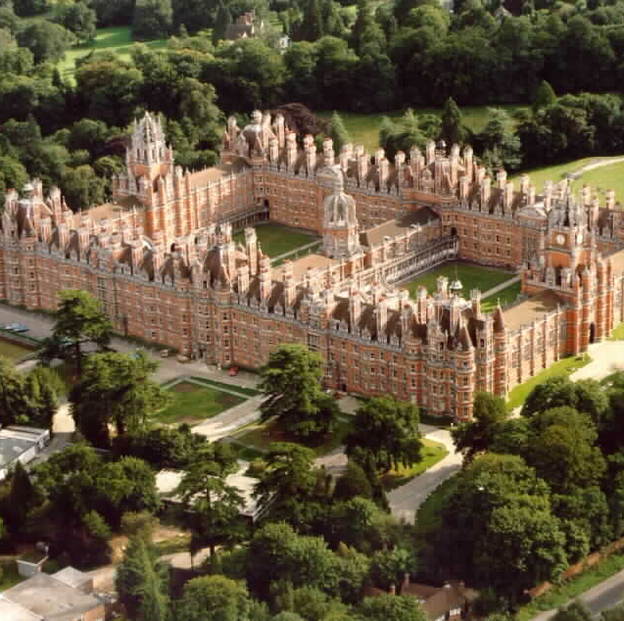
Ghana Via London
Illegal gold mining in Ghana is rampant
What are the environmental impacts?
Does it help or harm the locals?
Little data due to
Difficulty of finding mines
Challenge of gathering environment and demographic data
Research being done at Royal Holloway University

Slide 13
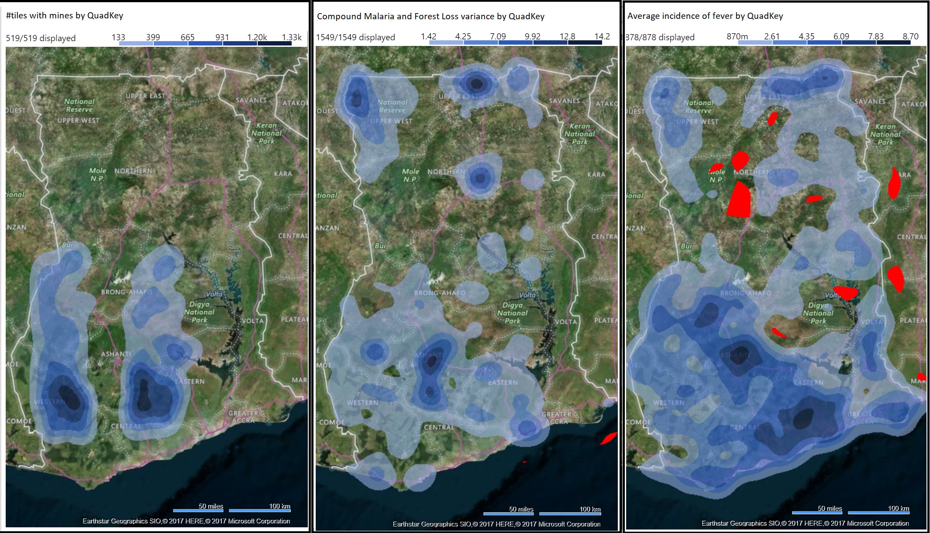
Gathering Data
Bing Maps tiles
Careful choice of zoom level
Quad-keys to pick regions of interest
Ghana Living Standards Survey
Deforestation Dataset
Child Health Data
Lighting Data

Slide 14
Transfer Learning
Base model trained on ImageNet: 14M images
Transfer that knowledge with 10s of images
Satellite images of Ghanaian landscapes are a very different domain, so more images are needed
“Transfer-Learning-as-a-Service”: https://customvision.ai/
But we wanted to process images once, in a single batch
Plus, it’s a university, so they wanted cheap
We used Keras with TensorFlow, as it was easy to build and explain
Topographic hotdog/not-hotdog: “Mine”/“Not Mine”
We needed a third class: “Clouds”
We needed different regions and data augmentation to avoid learning color classifiers

Slide 15
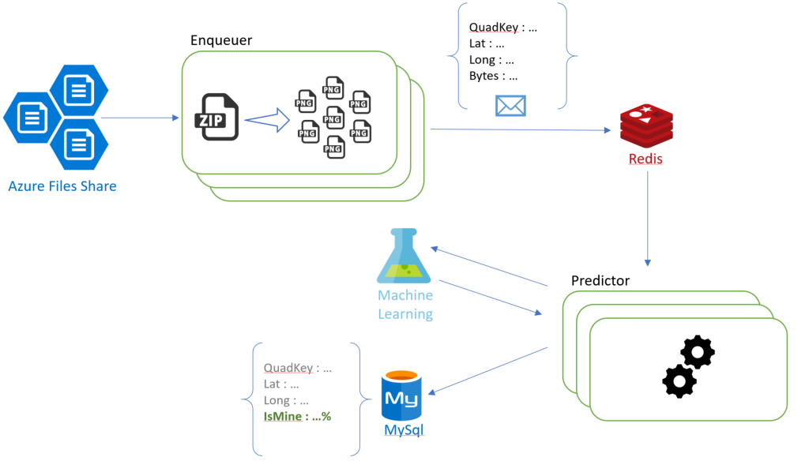
Scoring in Bulk
Azure File Share
Kubernetes
Queues in Redis
MySQL

Slide 16
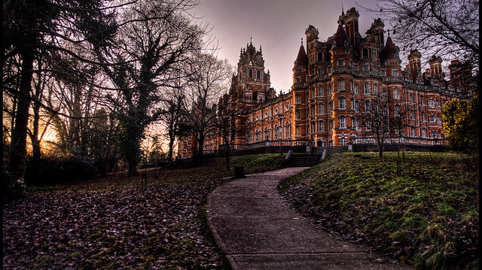
Sharing
https://github.com/noodlefrenzy/ImageRecognitionInKeras

Slide 17
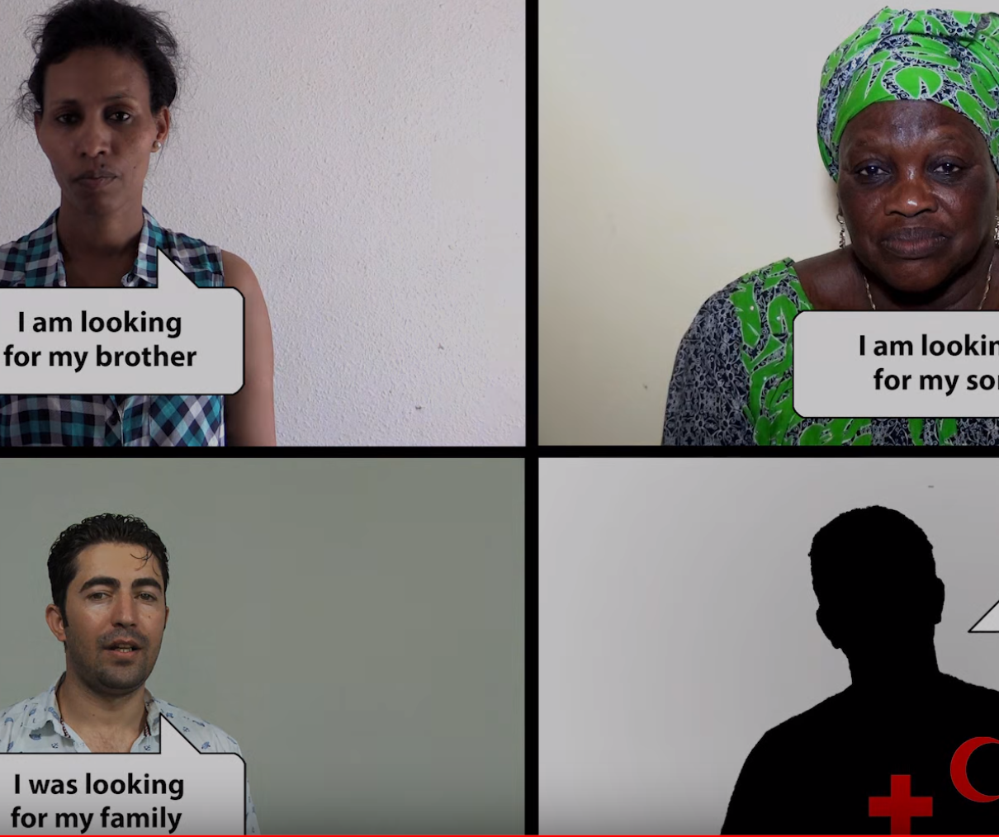
Red Cross
Refugee Crisis
ICRC’s “Trace the Face” (https://youtu.be/dVHHfPL3FlA)
How can we do a better job of reuniting refugee families?

Slide 18
Experimentation
Cognitive Services
https://azure.microsoft.com/en-us/services/cognitive-services/face
Limited number of faces ☹ at the time, but …
https://azure.microsoft.com/en-us/blog/announcing-new-milestones-for-microsoft-cognitive-services-vision-and-search-services-in-azure/
Also, need to run on-premises for data security requirements
FaceNet
https://github.com/davidsandberg/facenet
Face_recognition
https://github.com/ageitgey/face_recognition

Slide 19
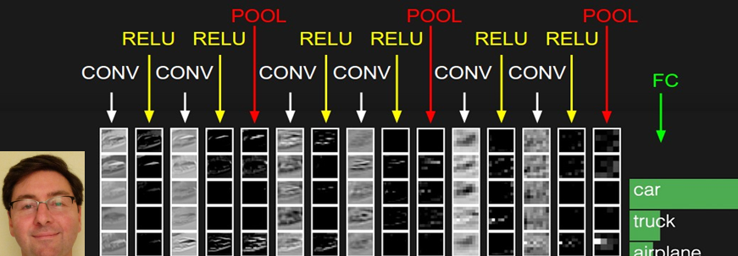
Facial Recognition using DL
Convnet feature maps produce “vectors” of facial features
Comparing the facial feature vectors using a distance metric (e.g. L2 Norm) can provide surprisingly accurate facial matching
Use these features to test similarity

Slide 20
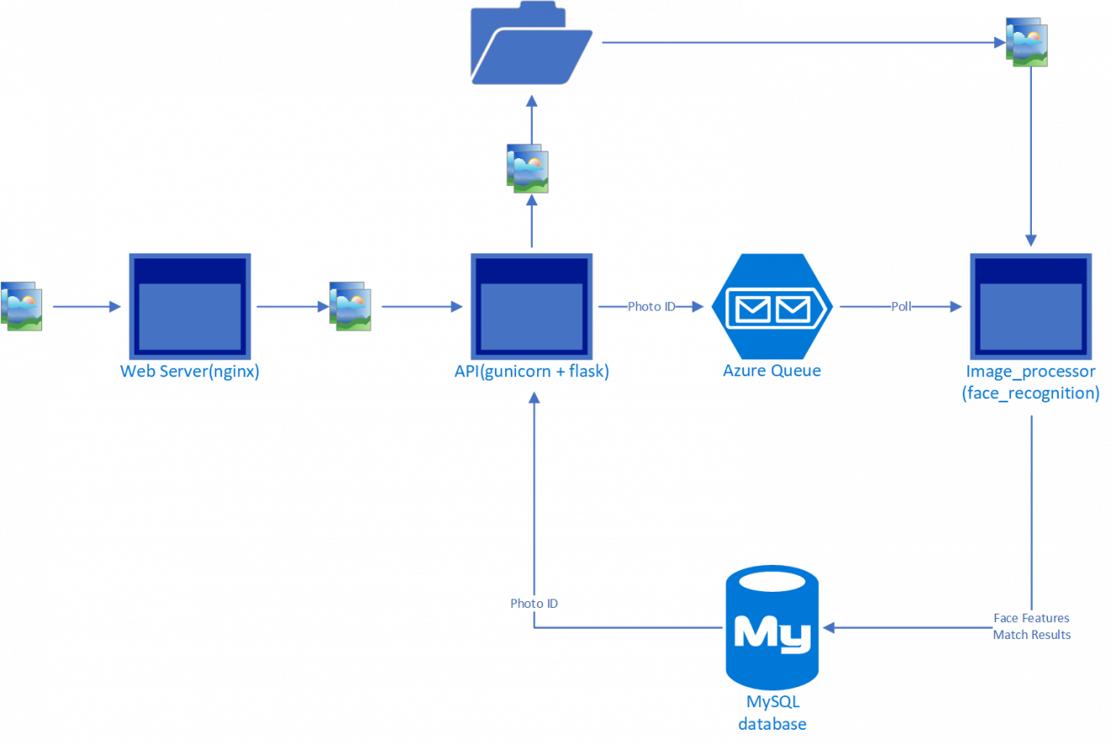
Sharing
https://www.microsoft.com/developerblog/2017/07/01/building-image-classification-pipeline-using-serverless-architecture/
(Use this if you don’t have to do all processing on-premise)
https://github.com/CatalystCode/faceanalysis
(Follow-up code story is almost published)

Slide 21
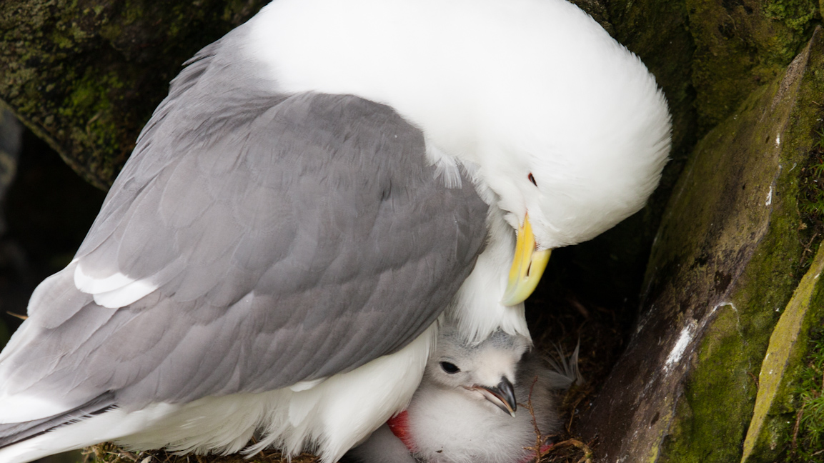
Conservation Metrics

Slide 22
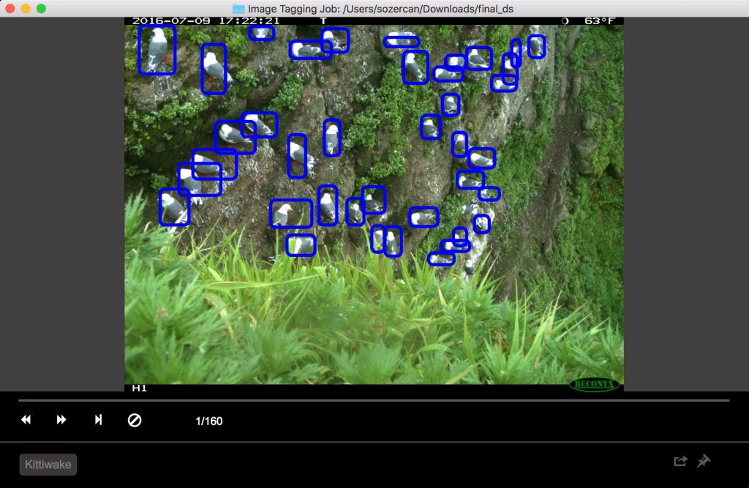
Training the Trainers
Visual Object Tagging Tool
https://github.com/CatalystCode/VoTT
Azure ML
https://azure.microsoft.com/en-us/overview/machine-learning/
Workbench: https://docs.microsoft.com/en-us/azure/machine-learning/preview/quickstart-installation
Services: https://docs.microsoft.com/en-us/azure/machine-learning/preview/

Slide 23
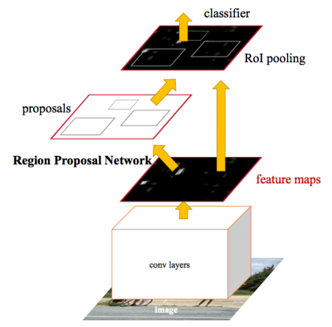
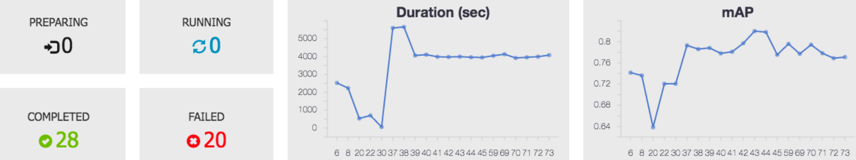
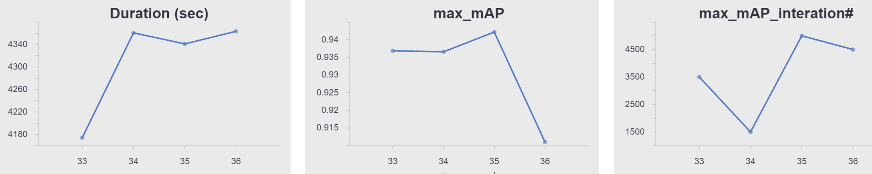
Tensor Throwdown
Object Detection
CNTK
TensorFlow
Faster R-CNN
https://arxiv.org/abs/1506.01497
https://docs.microsoft.com/en-us/cognitive-toolkit/object-detection-using-faster-r-cnn
Only AlexNet and VGG16 out of the box
https://github.com/tensorflow/models/blob/master/research/object_detection/g3doc/detection_model_zoo.md
Far more pre-trained models

Slide 24
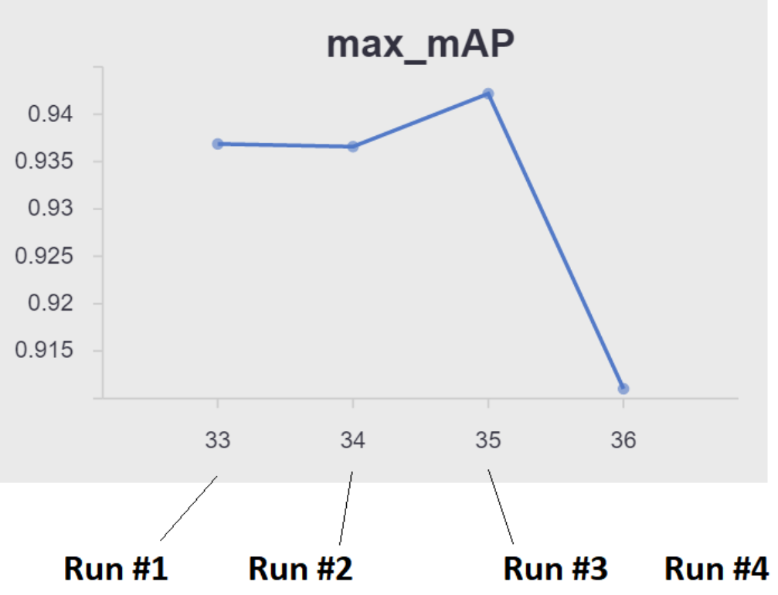
TensorFlow Tuning
AzureML Services + Data Science VMs
Four strategies explored
Basic: SGD, no augmentation (useful for baseline, shaking bugs out)
ADAM: Best model much more quickly, but then overfit
Random Horizontal Flip: Even better performance, but took longer, less prone to overfit
+ Random Crop/Scaling: Worse performance, but highly resilient to overfitting
We hooked TensorBoard outputs to Azure ML Logger to track process across runs
We used Azure API Management + Sanic for our scoring API

Slide 25
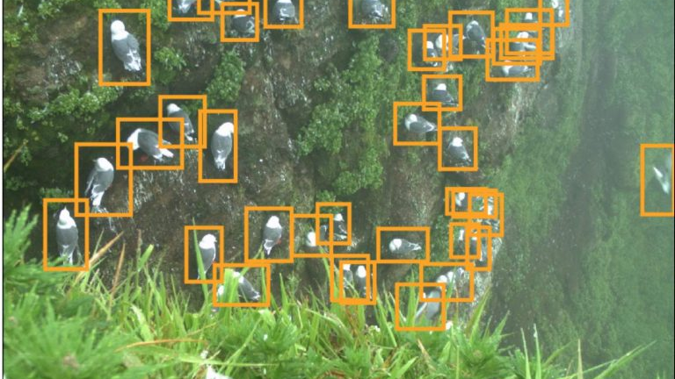
Sharing
https://www.microsoft.com/developerblog/2017/10/24/bird-detection-with-azure-ml-workbench/

Slide 26
Final Thoughts
Nonprofits and government organizations often have painfully manual processes
Simple machine learning and deep learning systems that we take for granted are groundbreaking
Know your problem
Legal and ethical restrictions can often add technical constraints
Users often don’t need “the right” answer, just a good one (decision support vs. decision-making)
Buy don’t build (but for free)
There are tons of open source solutions out there!
Transfer learning and feature-vectors can help!

Slide 27
Thanks!
Questions? I’ll be around after the talk.
Our team is hiring – milanz@Microsoft.com
This deck and all links: https://aka.ms/SGACS

